Slide 1
PRV 4 cell

Slide 2
TSS based analysis

Slide 3
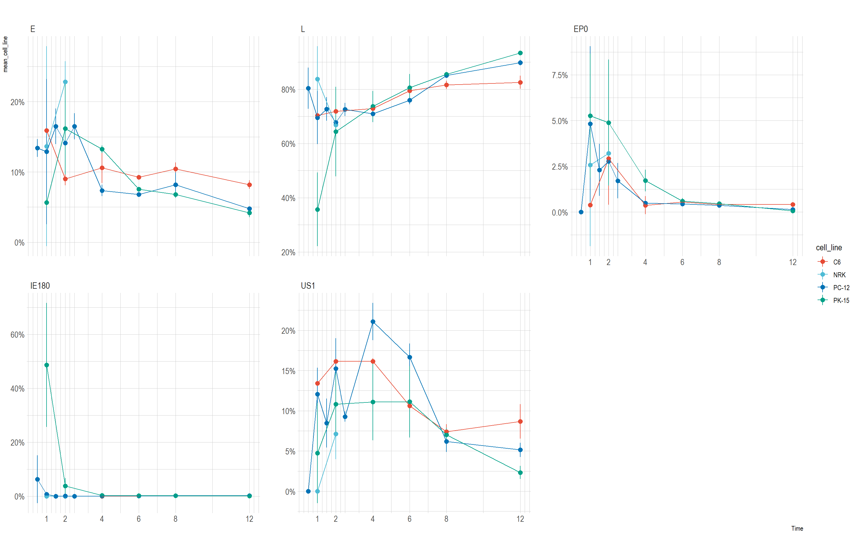

Slide 4
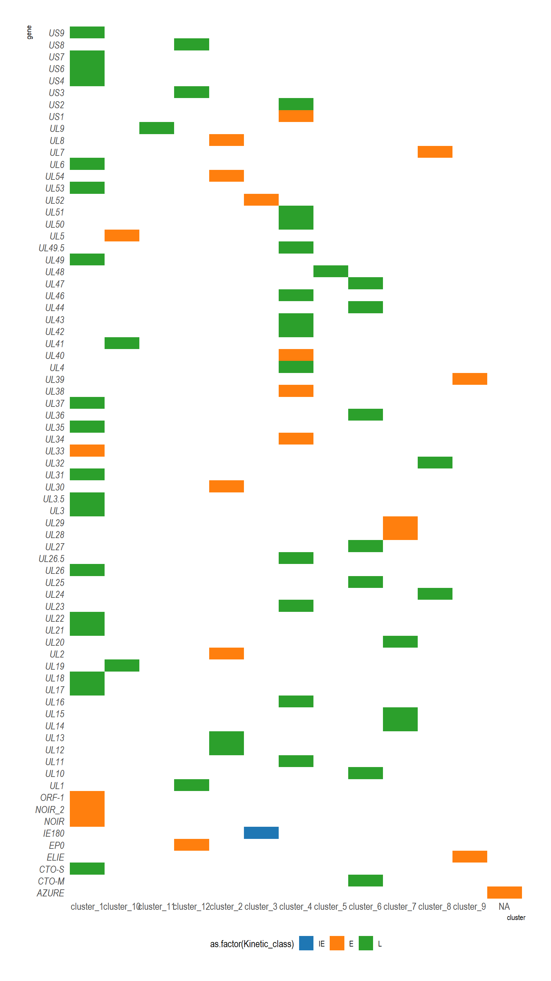
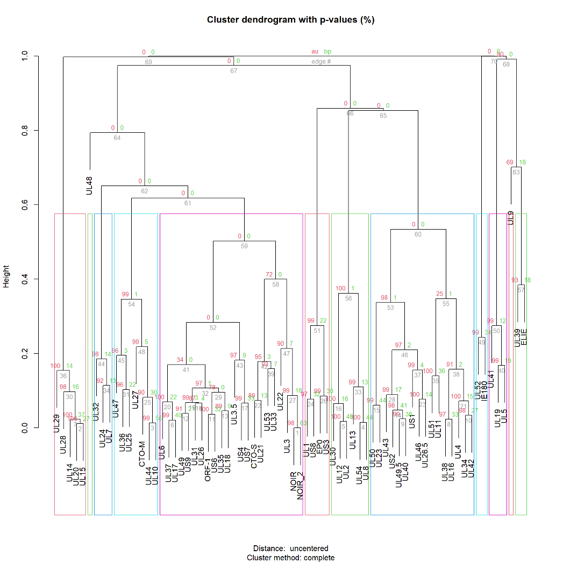

Slide 5
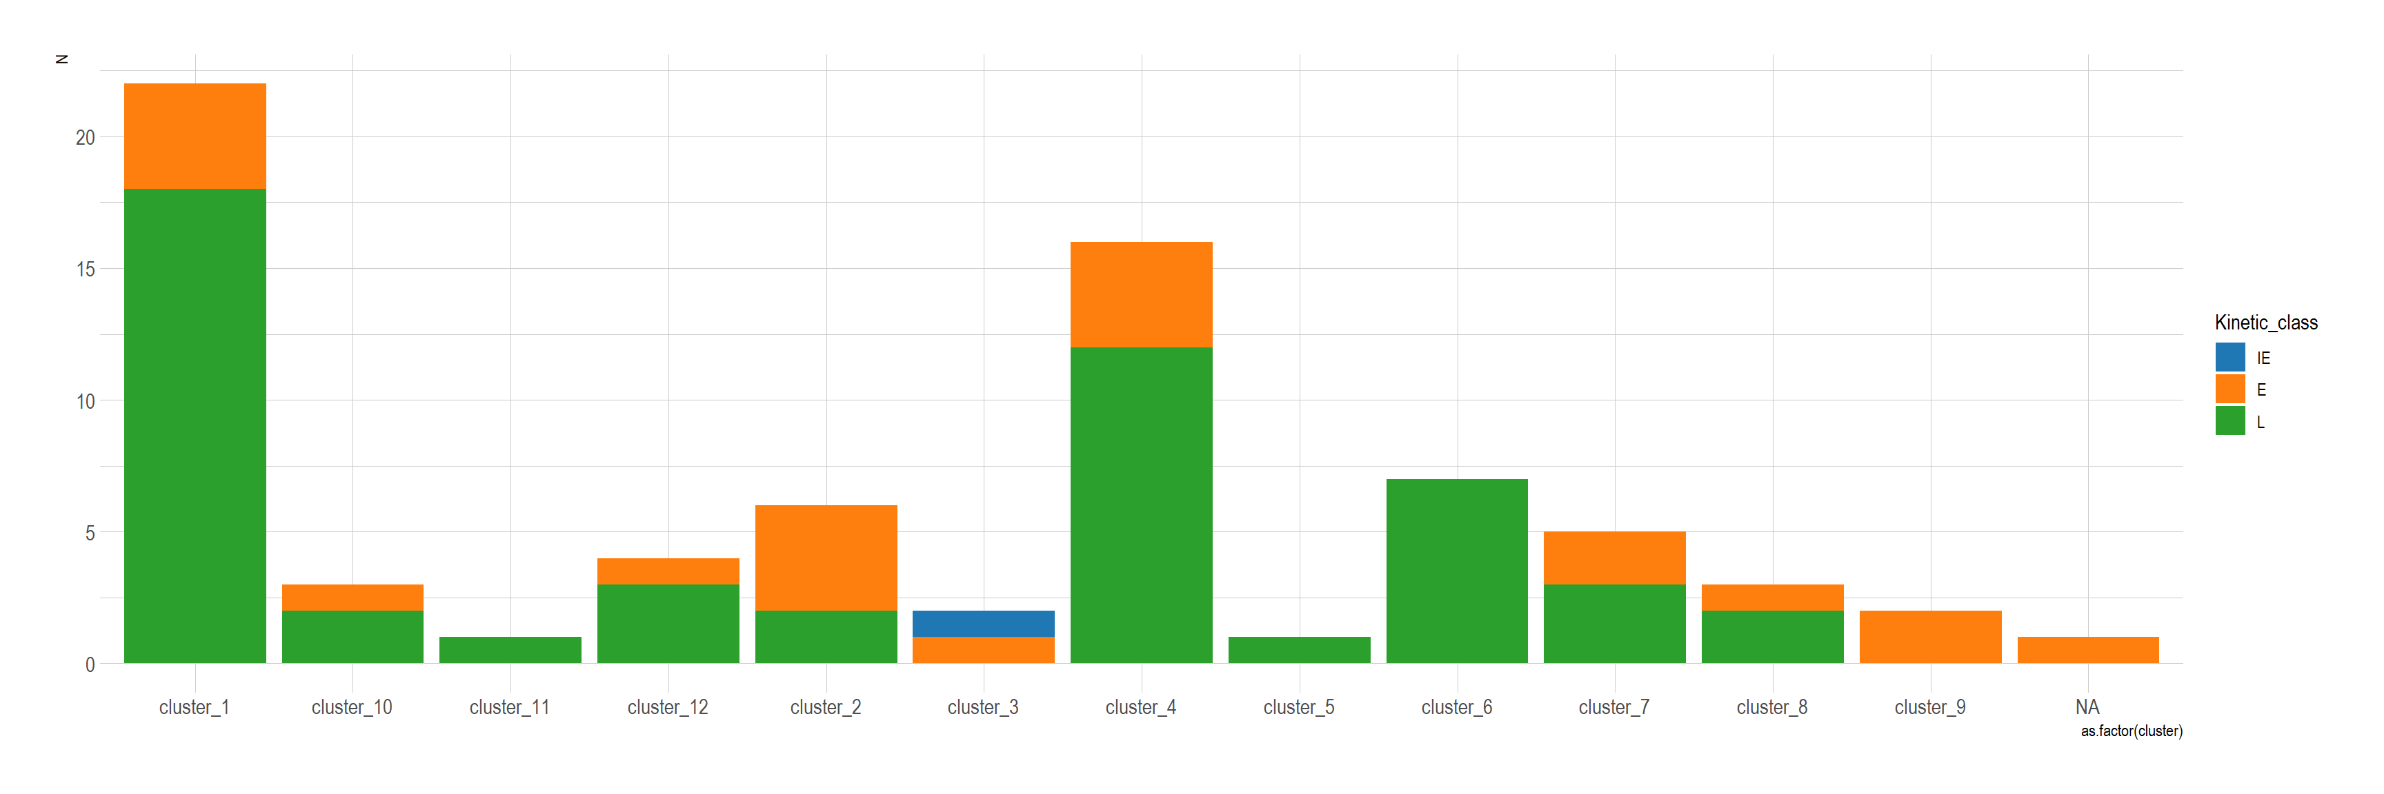

Slide 6
PK-15 TSS Clustering Conclusions
IE180 Anchors a True “Immediate” Cluster
The fact that IE180 sits in Cluster_3 with excellent silhouette support confirms that cluster as the earliest wave. UL52 (a known E gene) also lumps in there, indicating it has a very early surge.
Many “Early” and “Late” Genes End Up Intermixed
Several clusters (notably 1, 2, 4, 7, 8, 12) contain both E and L genes. This underscores the continuum of expression timings and suggests that some “early” genes keep going into mid/late infection, while a few “late” genes might begin transcription earlier than classically taught.
Sub‐Phases of Late Genes
Large sets of L genes split out among clusters_1, _4, _6, _7, _8, etc., implying multiple sub‐patterns among “late” transcripts—some might peak around 6–8 hpi, others around 8–10 hpi, and so on. This nuance is lost if one just lumps all L genes into one bin.
Biological Explanation
The transcriptome wave in alphaherpesviruses is not a sharp step‐function but an overlapping ramp—once certain viral proteins (like the IE180 transactivator) are made, transcription of many genes can be sustained or reactivated at later stages.
The cluster “mixing” of E and L is entirely consistent with prior data on “leaky‐late” or “early‐late” transcripts. Some also reflect that large transcripts can include multiple ORFs, or that host/viral factors continue to drive expression of nominally early genes in late infection.

Slide 7
TES based analysis

Slide 8
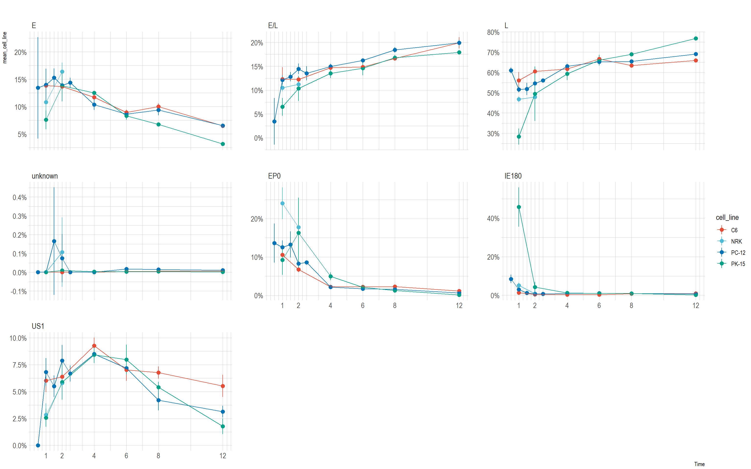

Slide 9
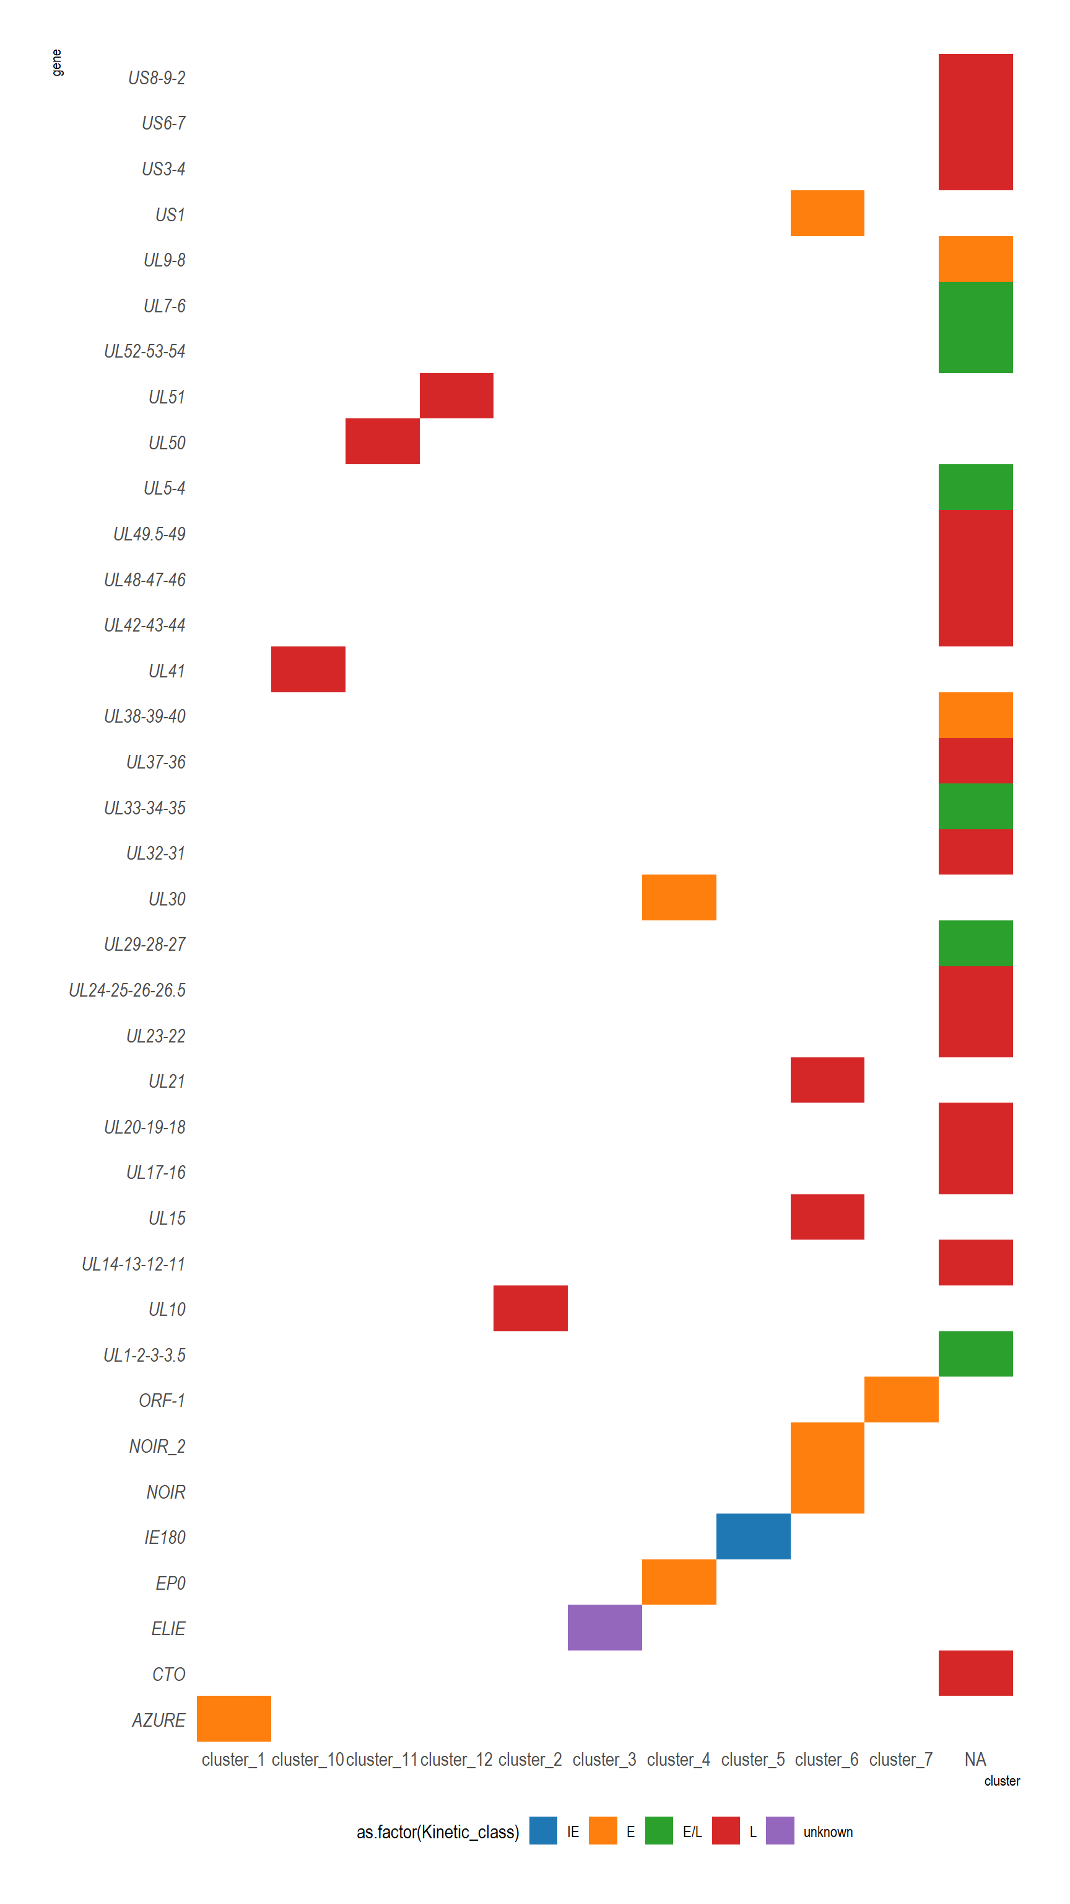
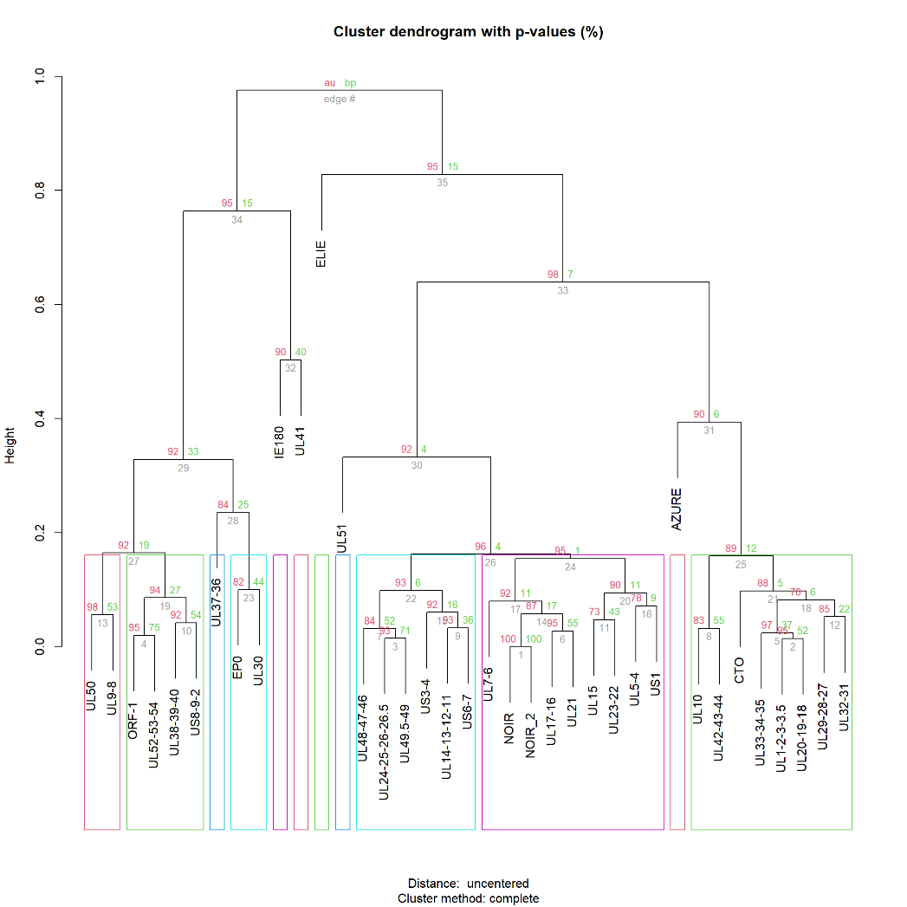

Slide 10
